Slide 1
Assignment on Visual Analysis in Detail
Submitted By: Pooran Pragnya
November Batch (BDS)

Slide 2
Scenarios
Duplicate the profit map and rename as negative profit map.
Represent the profit map in horizontal bar format.
Show only the states having negative profit in the bar graph.
Show city level negative profit in the bar graph
Show profit subcategory wise for all the states and city having negative profit
Show the profit in different color
Check the profit in 2020 and 2021
Find some meaningful information and suggest how can we increase the profit

Slide 3
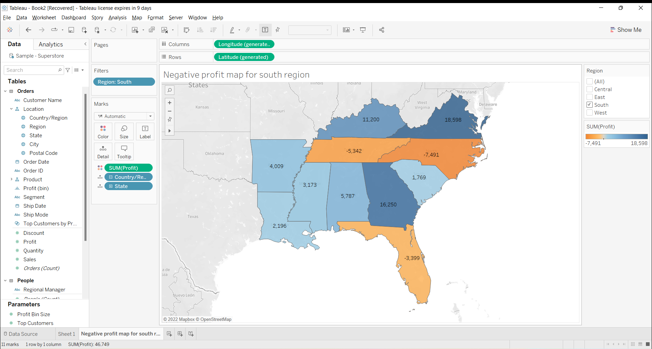
1. Duplicate the profit map and rename as negative profit map

Slide 4
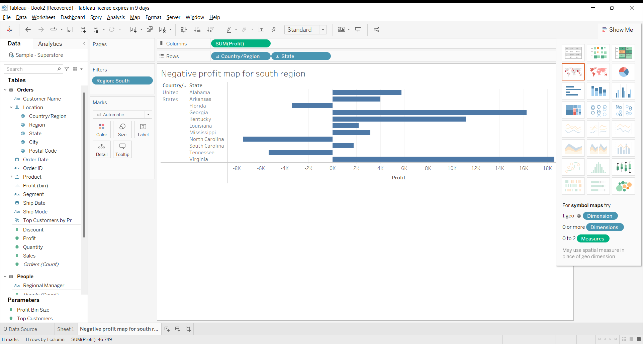
2. Represent the profit map in horizontal bar format

Slide 5
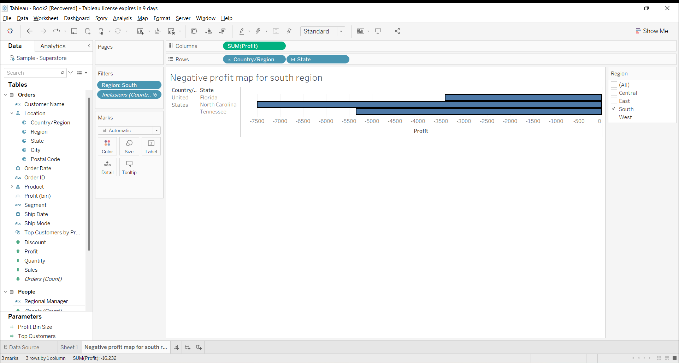
3. Show only the states having negative profit in the bargraph

Slide 6
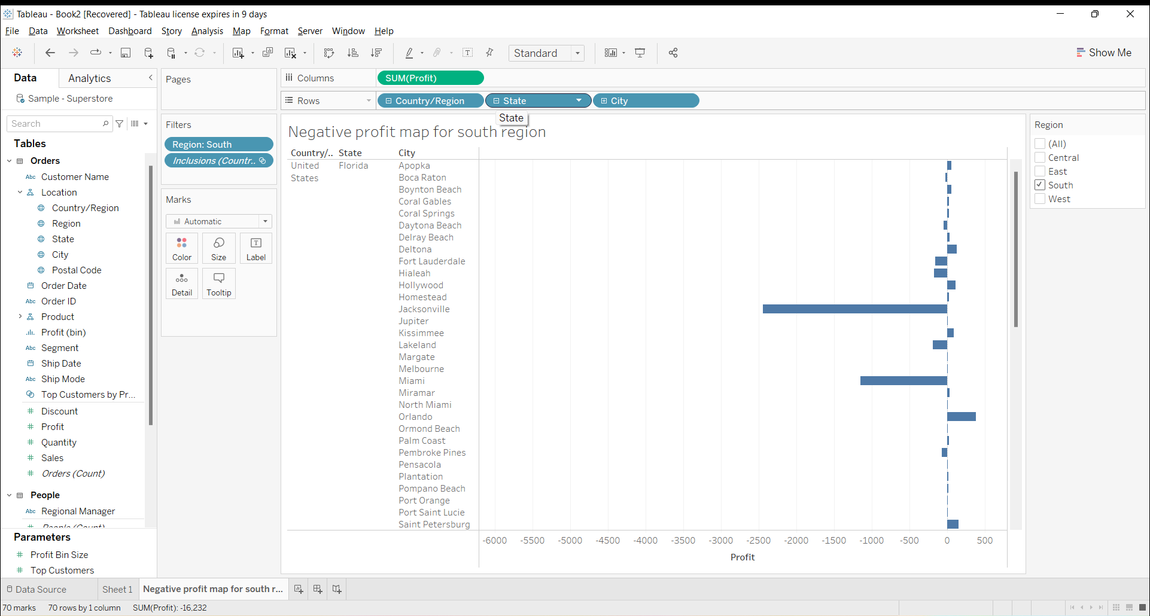
4. Show city level negative profit the bar graph

Slide 7
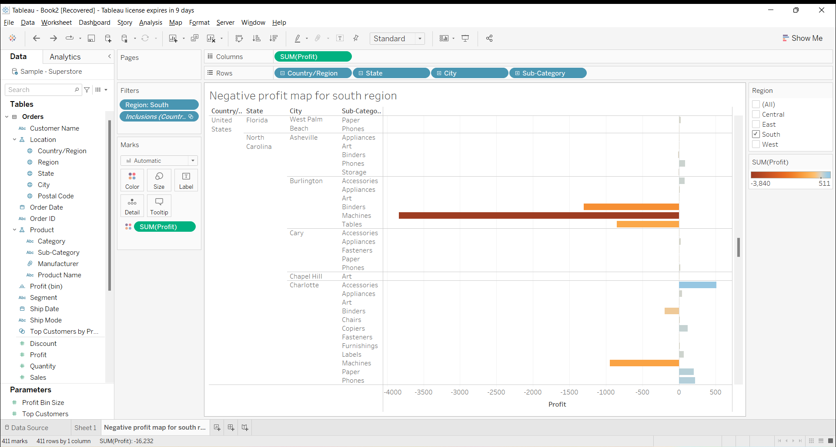
5.Show the profit subcategory wise for all the states and city having negative profit

Slide 8
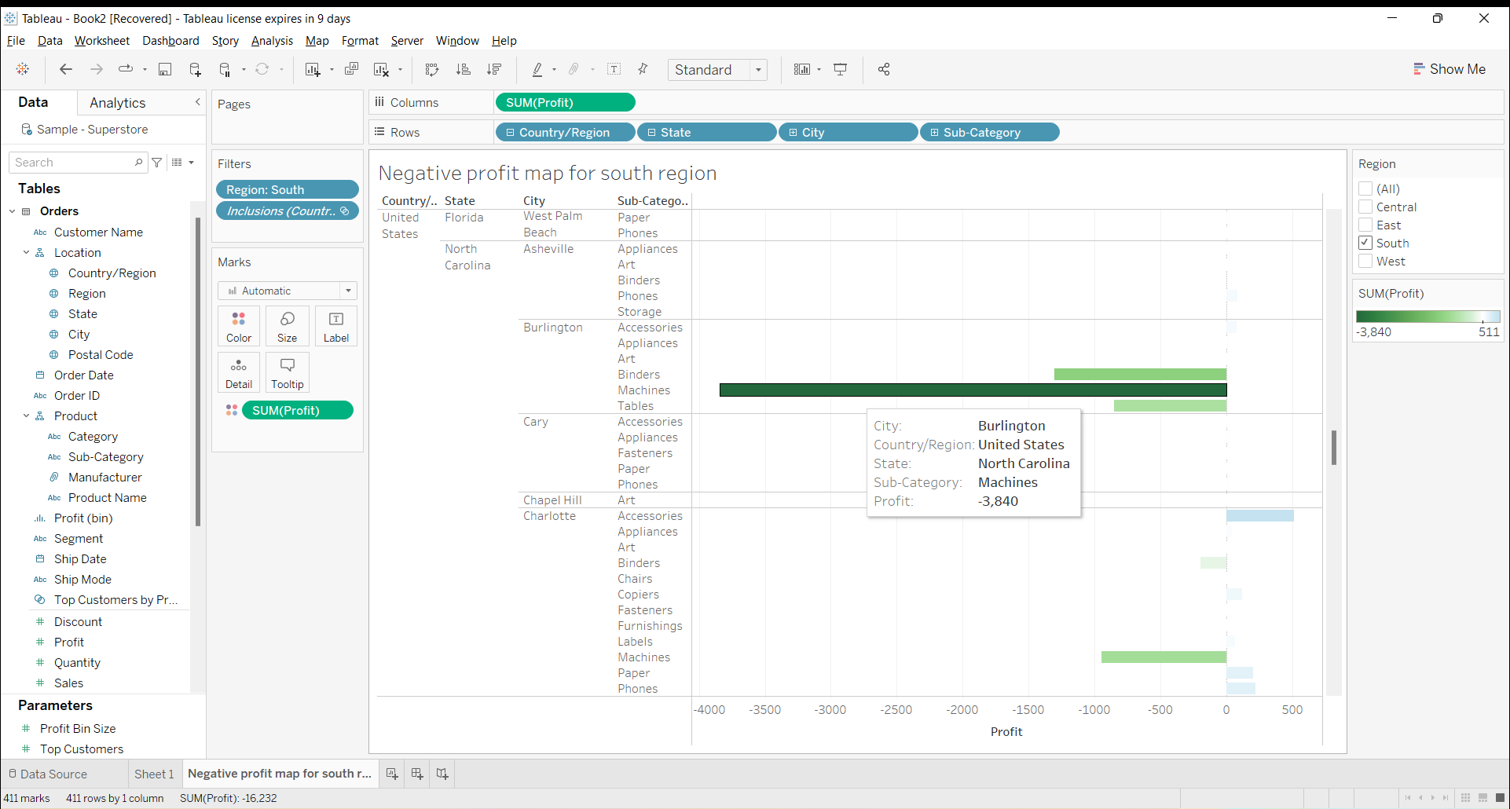
6. Show the profit in different color

Slide 9
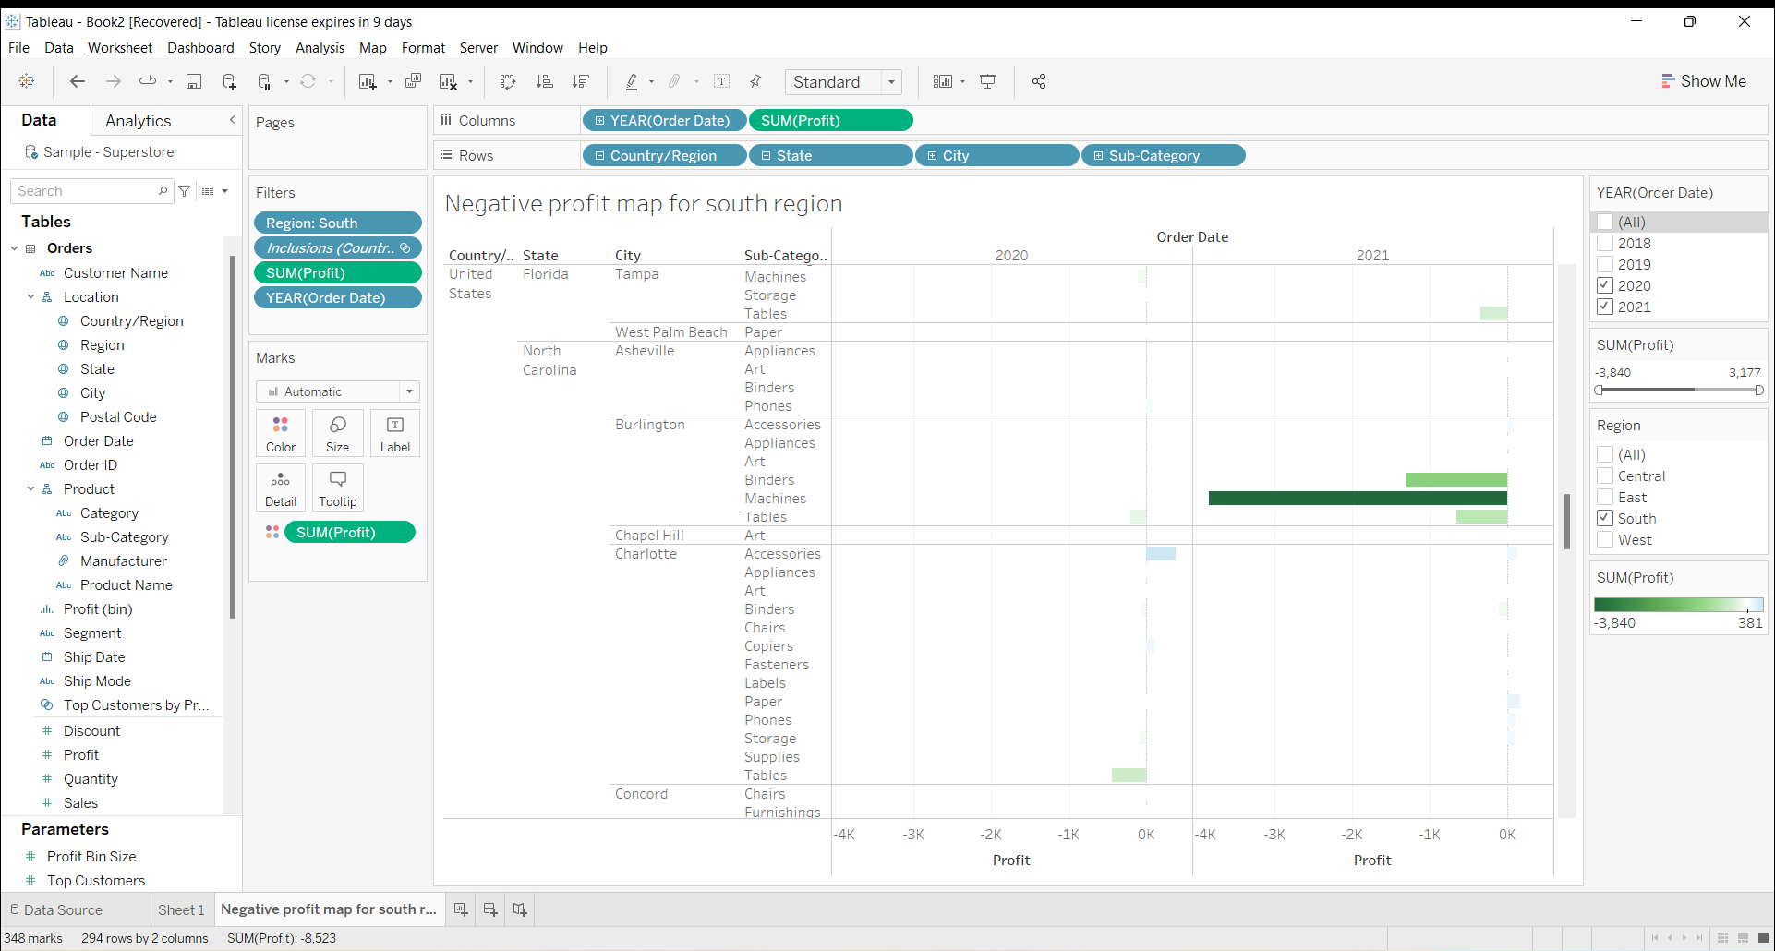
7. Check the profit in 2020 and 2021

Slide 10
8. Find some meaningful information and suggest how can we increase the profit
Ways to increase the profit:
In North Carolina, Burlington recorded highest overall negative profit when compared to other cities, if we see in detail under machine subcategory it recorded highest overall negative profit so focusing on that may improve the profit.
In contrast to this, Charlotte city (North Carolina) has recorded good positive profit when compared to other cities so there is increase in demand for the accessories in the city, forming new marketing strategies may increase the overall profit in the region.

